Slide 1
Lecture No. 39 Polymers
At the end of this lecture, students will be able to:
Describe the various methods of synthesis of polymers
Explain the significance and factors affecting of Tg

Slide 2
Methods of Production
Generally used techniques for polymerization are
Bulk Polymerization
Solution polymerization
Suspension polymerization
Emulsion polymerization

Slide 3
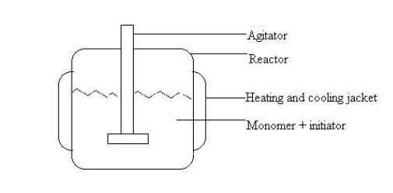
Bulk polymerization
Used for liquid monomers, Initiators are dissolved in the liquid monomers and form a homogeneous phase
Heating or exposing to the sunlight initiates the polymerization reaction
Reaction is exothermic and viscosity of medium increases as the reaction proceeds
Reaction mixture is stirred constantly to disperse the heat liberated

Slide 4
Bulk polymerization
Advantages:
Method is simple, products don’t require purification or isolation.
Products have high optical clarity, The purity of the products is high
Disadvantages:
Agitation becomes difficult due to viscosity build up
Heat control is more difficult
Applications: Method is used for making polymers such as PVC, PMMA, and PS etc.

Slide 5
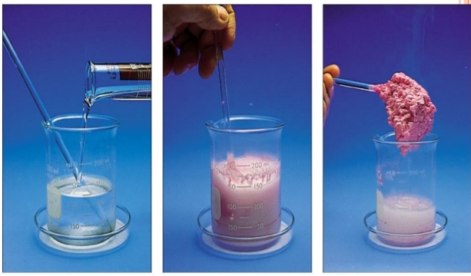
Solution polymerization
Polymerization occurs in homogenous system
Monomers & initiators dissolved in a suitable inert solvent and stirred
Inert solvent reduces the viscosity build up during the reaction progress & facilitates heat & mass transfer
In this method the obtained polymer can be easily separated from the solvent by evaporating the solution or it can be directly used for coating & adhesive purposes

Slide 6

Solution polymerization
Advantages
Viscosity produced in the reaction is negligible.
Better heat transfer can be achieved.
In solution face the polymer can be directly used as paintings, coating, & adhesive purposes
This method is used for preparation of polythene, pvc, polyacrylonitrile, etc

Slide 7
Suspension Polymerization
In this method water insoluble monomers are suspended in water as tiny droplets by continuously agitating (shaking).
Initiators are soluble in monomers, monomers and initiator forms heterogeneous mixture with the water
Polymerization is initiated by heating or exposing to radiation
The polymerization takes place within the tiny droplets the polymer is
obtained as spherical pearls or beads hence it is also called as pearl
polymerization methods
Since the product is insoluble in water
It can be easily separated just by filtration and the product needs no further purification.

Slide 8
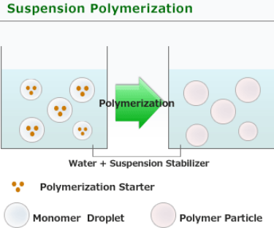
Suspension Polymerization
Advantages:
Viscosity build up is negligible
Better heat transfer can be achieved
High purity product is obtained
Isolation of the product is easy and it does not require any purification
Uses: This method is used for preparing PVC, PVA (Polyvinyl acetate), styrene, divinyl benzene (ion exchanger)

Slide 9

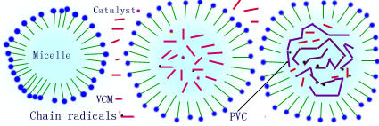
Emulsion Polymerization
Emulsion polymerization
Avoids most of the disadvantages of the other methods

Slide 10
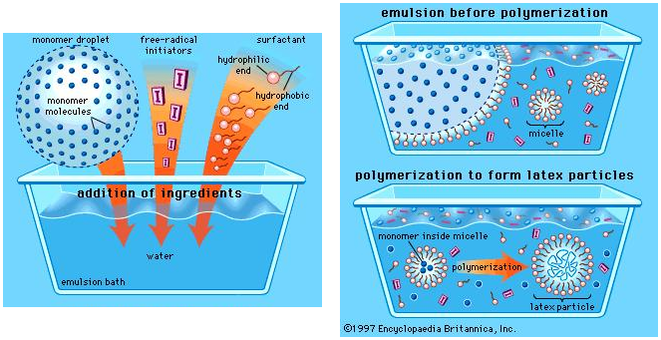
Emulsion Polymerization
http://www.britannica.com/EBchecked/media/121408/Schematic-diagram-of-the-emulsion-polymerization-method

Slide 11
Emulsion Polymerization
Essential ingredients are water insoluble monomer, water soluble initiator (H₂O₂) and surface active agents-soaps or detergents
Water insoluble monomer is dispersed in water not as discrete droplets but as uniform emulsion
Emulsion is stabilized by adding surface active agents
After adding the initiator, the system is kept agitated in absence of oxygen at 70⁰C
Surfactants such as soap or detergents, etc are add which hold the monomers & initiators (H₂O₂ or per sulphate) in the form of a micelles
Polymerization takes place inside the micelle on exposing to heat or radiation
Filtration & deemulsifying agents can isolate the obtained polymer.

Slide 12
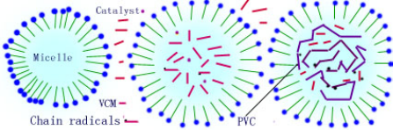
Emulsion Polymerization
Advantages:
Rate of polymerization is high
Viscosity build up is negligible
Better heat transfer can be achieved
High purity product is obtained isolation is easy
Method is used to prepare PVC, adhesive etc.

Slide 13
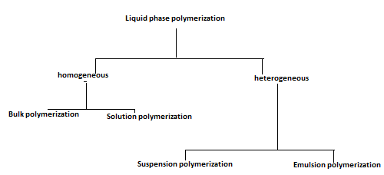
Polymerization Techniques
Type and size of the particles in which polymerization occurs and kind of initiator employed
Monomer + Initiator
Monomer + initiator
dissolved solvent
Hydrophobic monomer droplets, of diameter in the range of 0.5 -10 µm
Hydrophobic monomer + Initiator
in water
Hydrophobic Monomer + Initiator surfactant in water
Droplets (10-1000µm)

Slide 14
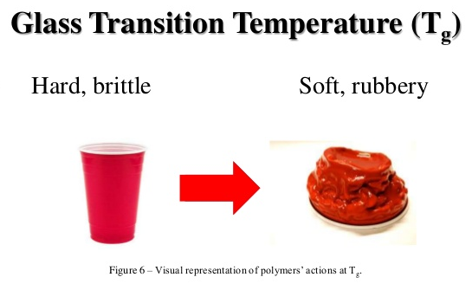
Definition
Glass temperature is the temperature at which a polymer transforms from the glassy (hard) to the rubbery state (soft)
Glassy state → Tg → Rubbery state.

Slide 15
Significance of Glass Transition Temperature:
T_{g} value is an important parameter of polymers
Decides whether the polymer at a particular temperature behaves like rubber and plastic
T_{g} value measures the flexibility of the polymer
Helps in predicting the response of a polymer to mechanical stress and also in predicting the coefficient of thermal expansion, heat capacity, refractive index, modulus of elasticity and electrical properties
Useful in deciding the use of polymer over a range of temperature

Slide 16
Significance of Glass Transition Temperature:
Helps in determining the suitability of a polymer for a particular application
Useful in choosing appropriate temperature range for processing operations such as molding, extrusion of polymer, etc

Slide 17
Parameters affecting T_{g}
Crystallinity
Molecular weight
Effect of side group
Intermolecular forces
Presence of plasticizers
Stereoregularity

Slide 18
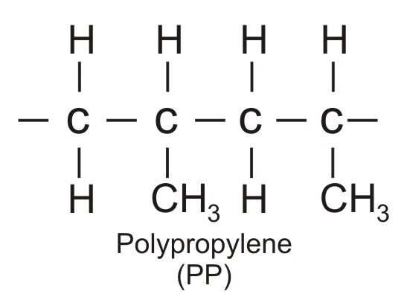
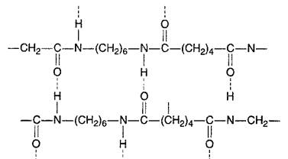
Parameters affecting T_{g}
Crystallinity
Higher the crystallinity, higher is the T_{g} value of a polymer
Eg: polyethylene has low T_{g} compared to that of nylon 6, 6
Tg = - 18 ⁰C
Tg = 57 ⁰C

Slide 19
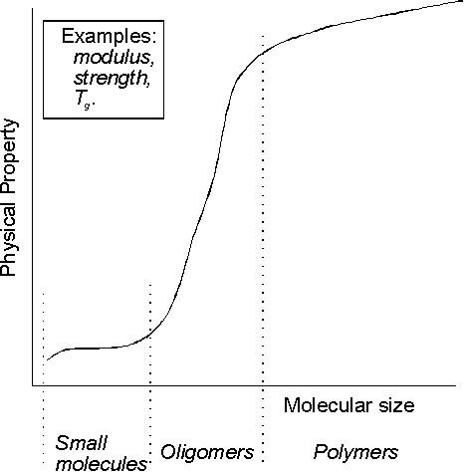
Factors affecting T_{g}
Molecular weight
In general, increase in
molecular weight, the T_{g}
of polymers also increases
High molecular mass restricts
rotation about the C - C chain

Slide 20
Factors affecting Glass Transition Temperature
Beyond degree of polymerization of 250, the increase in T_{g} is not significant
Additives: A polymer with plasticizer has a lower T_{g} because of the flexibility offered by the plasticizer
PVC has a T_{g} of 80⁰C and addition of diisooctyl phthalate (a plasticizer) reduces the T_{g} to 20⁰C

Slide 21
Factors affecting T_{g}
Effect of side group
Poly [α- methyl styrene] has higher T_{g} value while polystyrene has lower T_{g} value, is due to the presence of effective methyl side group which hinders the free rotation about carbon-carbon bond of chain back bone, and restricts the chain mobility, thereby increase T_{g} value

Slide 22
Factors affecting T_{g}
Polymers with electrostatic attraction (such as hydrogen bonds) between the polymer molecules offer resistance to molecular rotation and hence have a high T_{g}
Tg = - 18 ⁰C
Tg = 57 ⁰C

Slide 23
Factors affecting T_{g}
Intermolecular forces
Presence of large number of polar groups in the molecular chain lead to strong intermolecular cohesive forces which restrict the molecular mobility leading to an increase in T_{g}
Effect of Plasticizer:
Plasticizer is the molecule that increase the plasticity or fluidity of a material
Addition of plasticizers reduces the T_{g} value
Eg: Diisooctyl phthalate, which is added to PVC reduces its T_{g} (from 80°C to 20°C)

Slide 24
Summary
Bulk Polymerization:
Simple equipment required, Viscosity increases, difficult to control heat generation
Solution polymerization:
Reaction can be controlled, expensive, large quantities of solvents are required
Suspension polymerization:
Very cheap, product isolation easy, useful for water-insoluble monomers, polymer size cannot be controlled
Emulsion polymerization
Product isolation easy, useful for water-insoluble monomers, polymer size can be controlled
T_{g}: Temperature, below which a polymer is hard and above which it is soft and flexible
Factors effecting T_{g} : Crystallinity, Molecular weight, Effect of side group, Intermolecular forces, Presence of plasticizers, Stereo regularity

